Slide 1
Hand-Written Letter Recognition
Jorge Velasquez, Zhiquan Cao

Slide 2
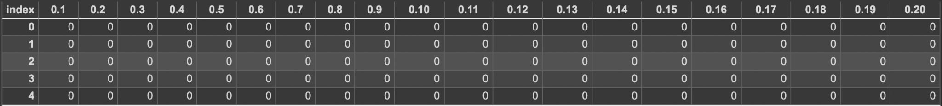
Dataset
Over 370,000 gray-scaled handwritten letters in 28x28 pixel images from Kaggle

Slide 3
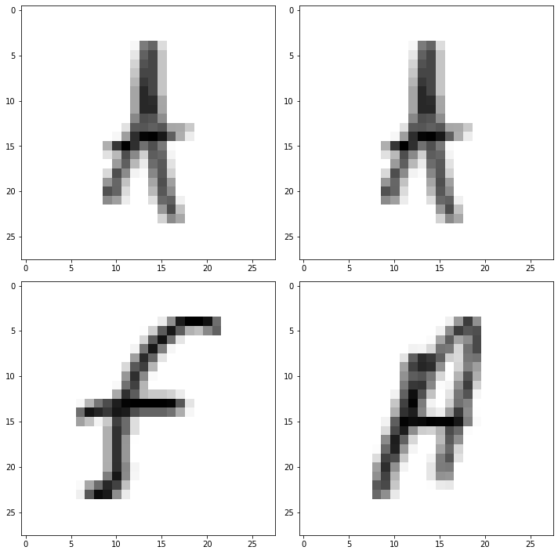
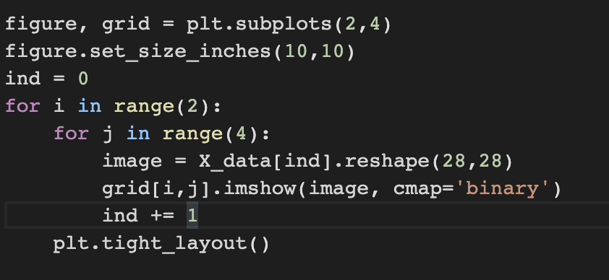
Example

Slide 4
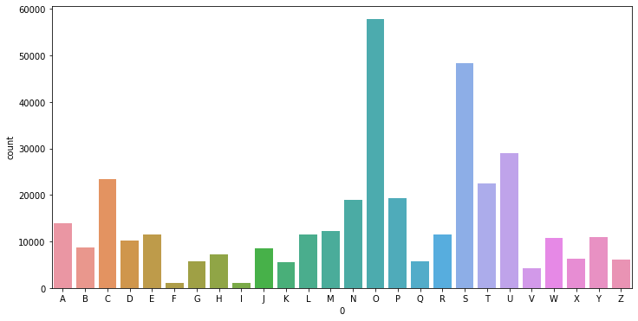
Processing the data
Before:

Slide 5
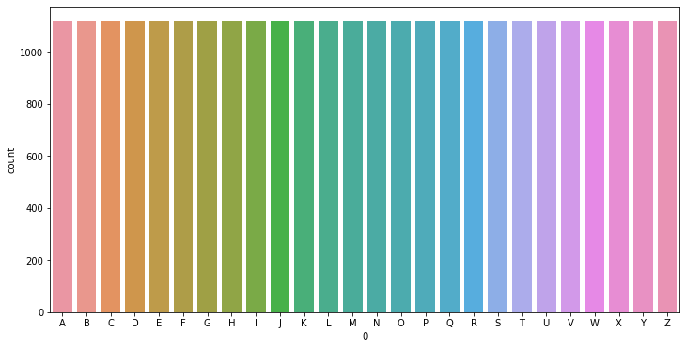
Using NearMiss
After:

Slide 6
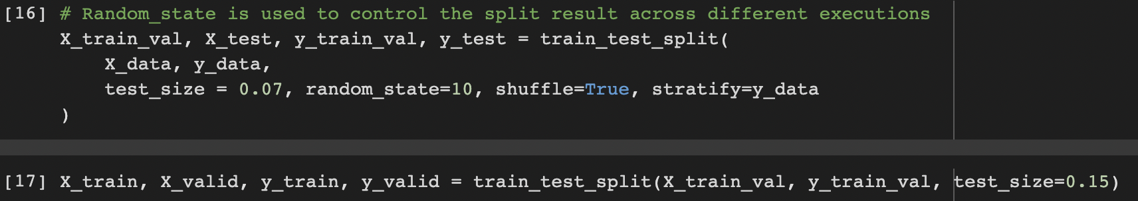
Split the Data

Slide 7
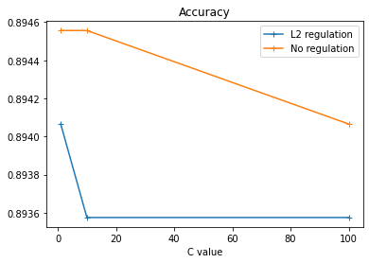
Logistic Regression
 | L2 | None
1 | 0.89406 | 0.89455
10 | 0.89357 | 0.89455
100 | 0.89357 | 0.89406

Slide 8
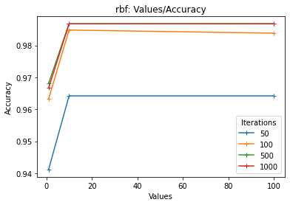
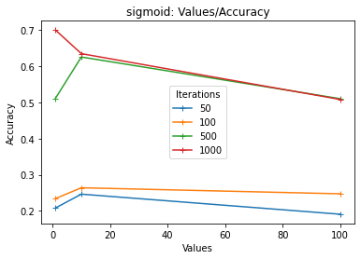
SVM
RBF and Sigmoid kernels: how accuracy changes against C_values

Slide 9
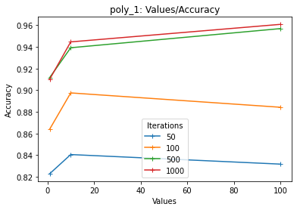
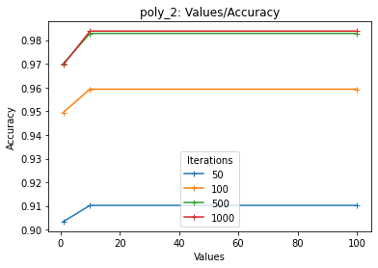
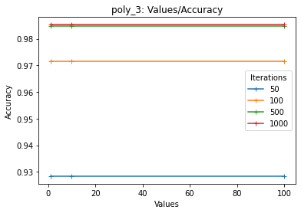
SVM
Polynomial Kernels

Slide 10
Neural Network
Three models:
One Convoluted2D layer
Three Convoluted2D layers
Five Convoluted2D layers
Three batch sizes: 32, 128, 256
3*3=Nine sets of outcomes

Slide 11
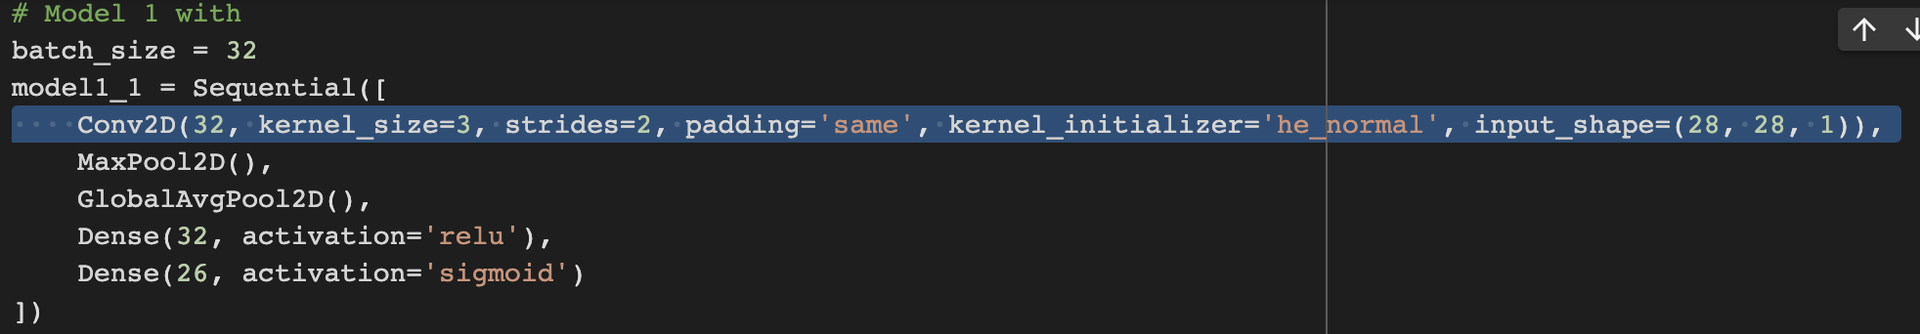
Model 1

Slide 12
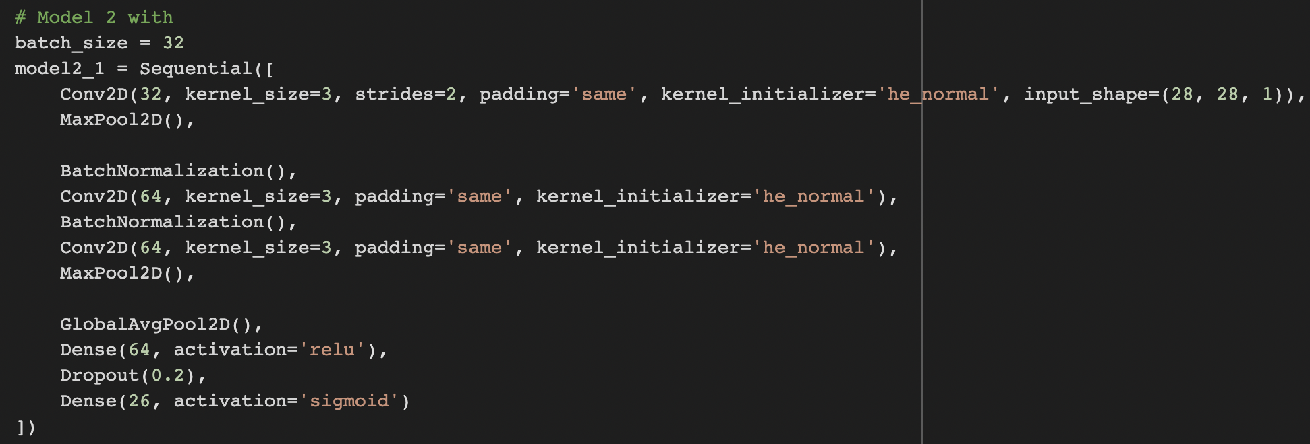
Model 2

Slide 13
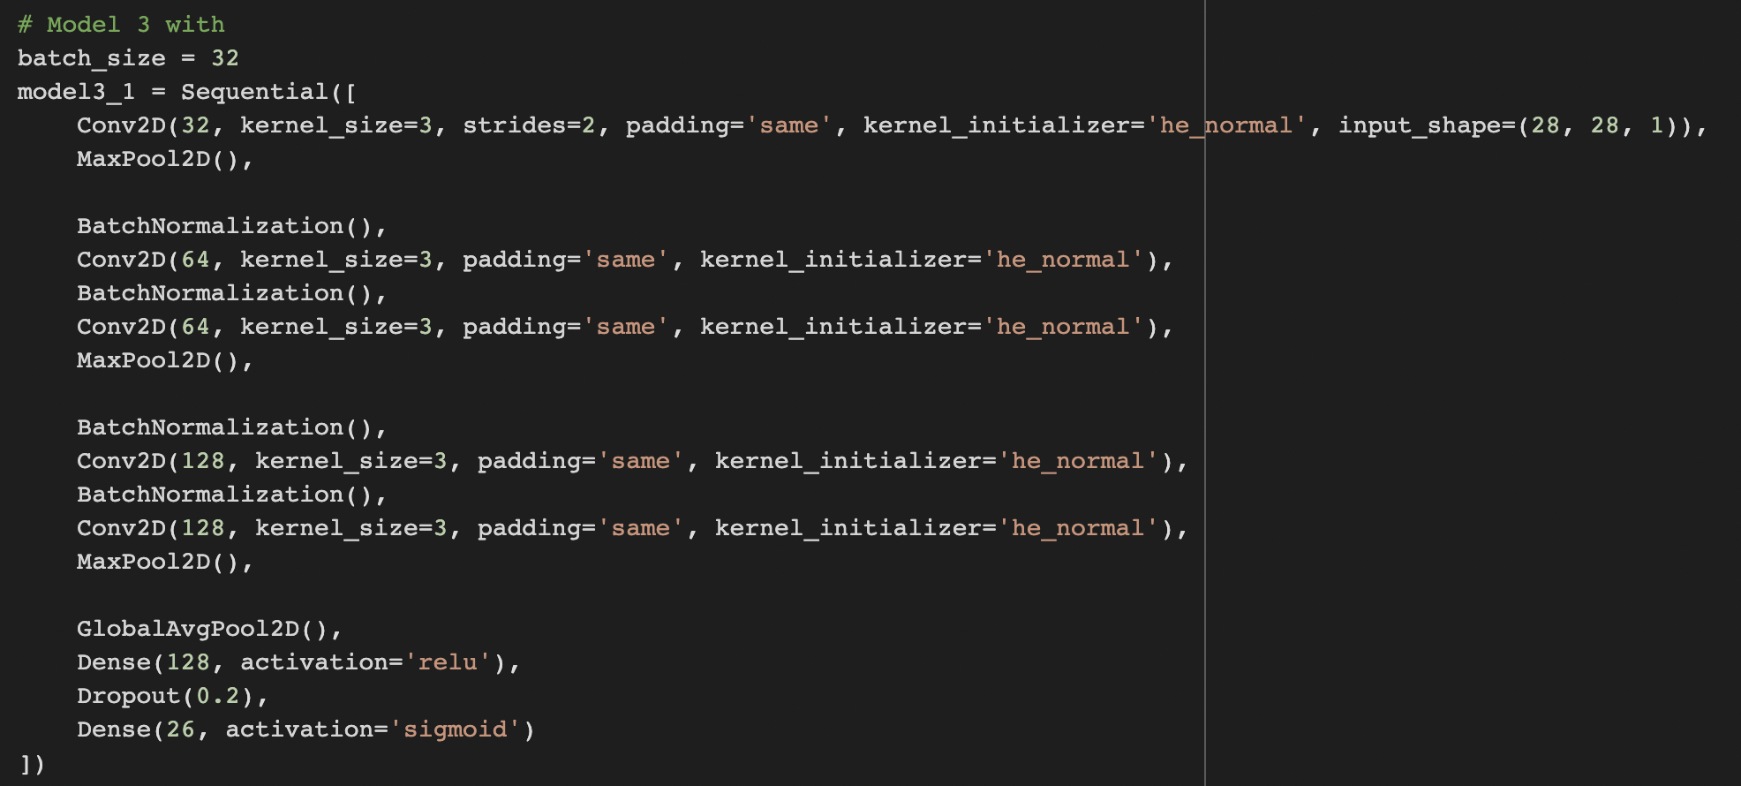
Model 3

Slide 14
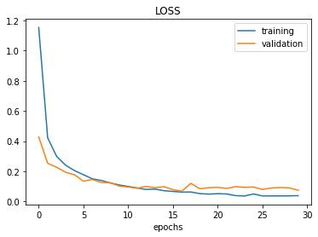
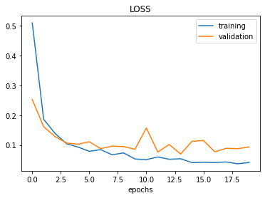
Accuracy Of The Three Models
Model1 accuracy (with one convolution layer): 0.6194
Model2 accuracy (with three convolution layer): 0.9823
Model3 accuracy (with five convolution layer): 0.9804
Model 2 with batch size 32
Model 3 with batch size 32

Slide 15
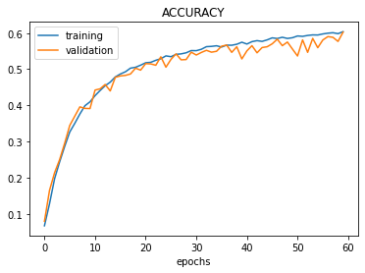
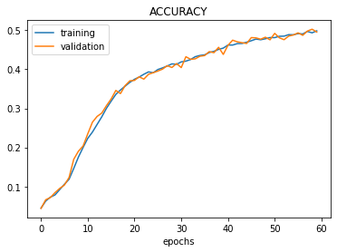
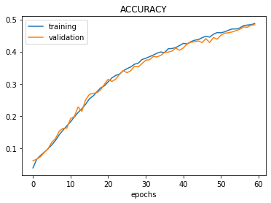
Batch Sizes
Take Model 1 for example
Batch size 32
Batch size 128
Batch size 256

Slide 16

Thank You !!

